Slide 1






The Netherlands eScience Center

Slide 2

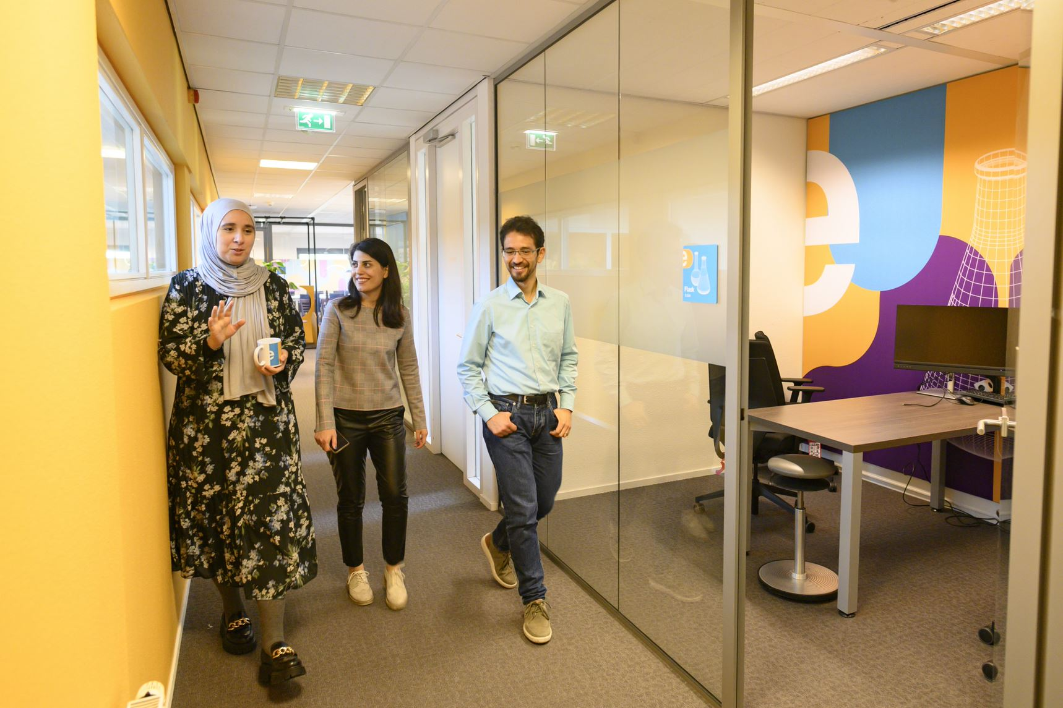

Who are we?
The Netherlands eScience Center is a national center for innovative software solutions in academic research.
Our Research Software Engineers
help researchers interpret results,
make tools and methods reusable for the wider research community,
co-author research and methodological publications.

Slide 3

Training Programme Schedule 2024
January |  | July
February | Introduction to deep learning Good Practices in Research Software Development | August
March | Image Processing with Python Parallel Programming with Python | September | Introduction to Deep Learning (2 full days in-person) Image Processing with Python (3 full days in-person) Intermediate Research Software Development with Python (spread over 5 weeks online)
April | Good Practices in Research Software Development Machine learning in python with scikit-learn Intermediate Research Software Development with Python | October | Machine learning in python with scikit-learn (2 full days in-person) Good Practices in Research Software Development (2 full days in-person)
May | Introduction to Geospatial Raster and Vector Data with Python Collaborative version control with git and GitHub | November | Introduction to Geospatial Raster and Vector Data with Python (2 full days in-person) Parallel Programming with Python (online)
June | GPU programming Carpentries instructor training | December | GPU programming (2 full days in-person)
For exact dates of upcoming workshops (3 months in advance): esciencecenter.nl/events/?f=workshops
To be notified about coming up workshops, subscribe to the Newsletter: eepurl.com/dtjzwP

Slide 4
Do you want to teach with our materials?
All material that we use is open-source and available online
We can help you setup workshops, contact training@esciencecenter.nl

Slide 5
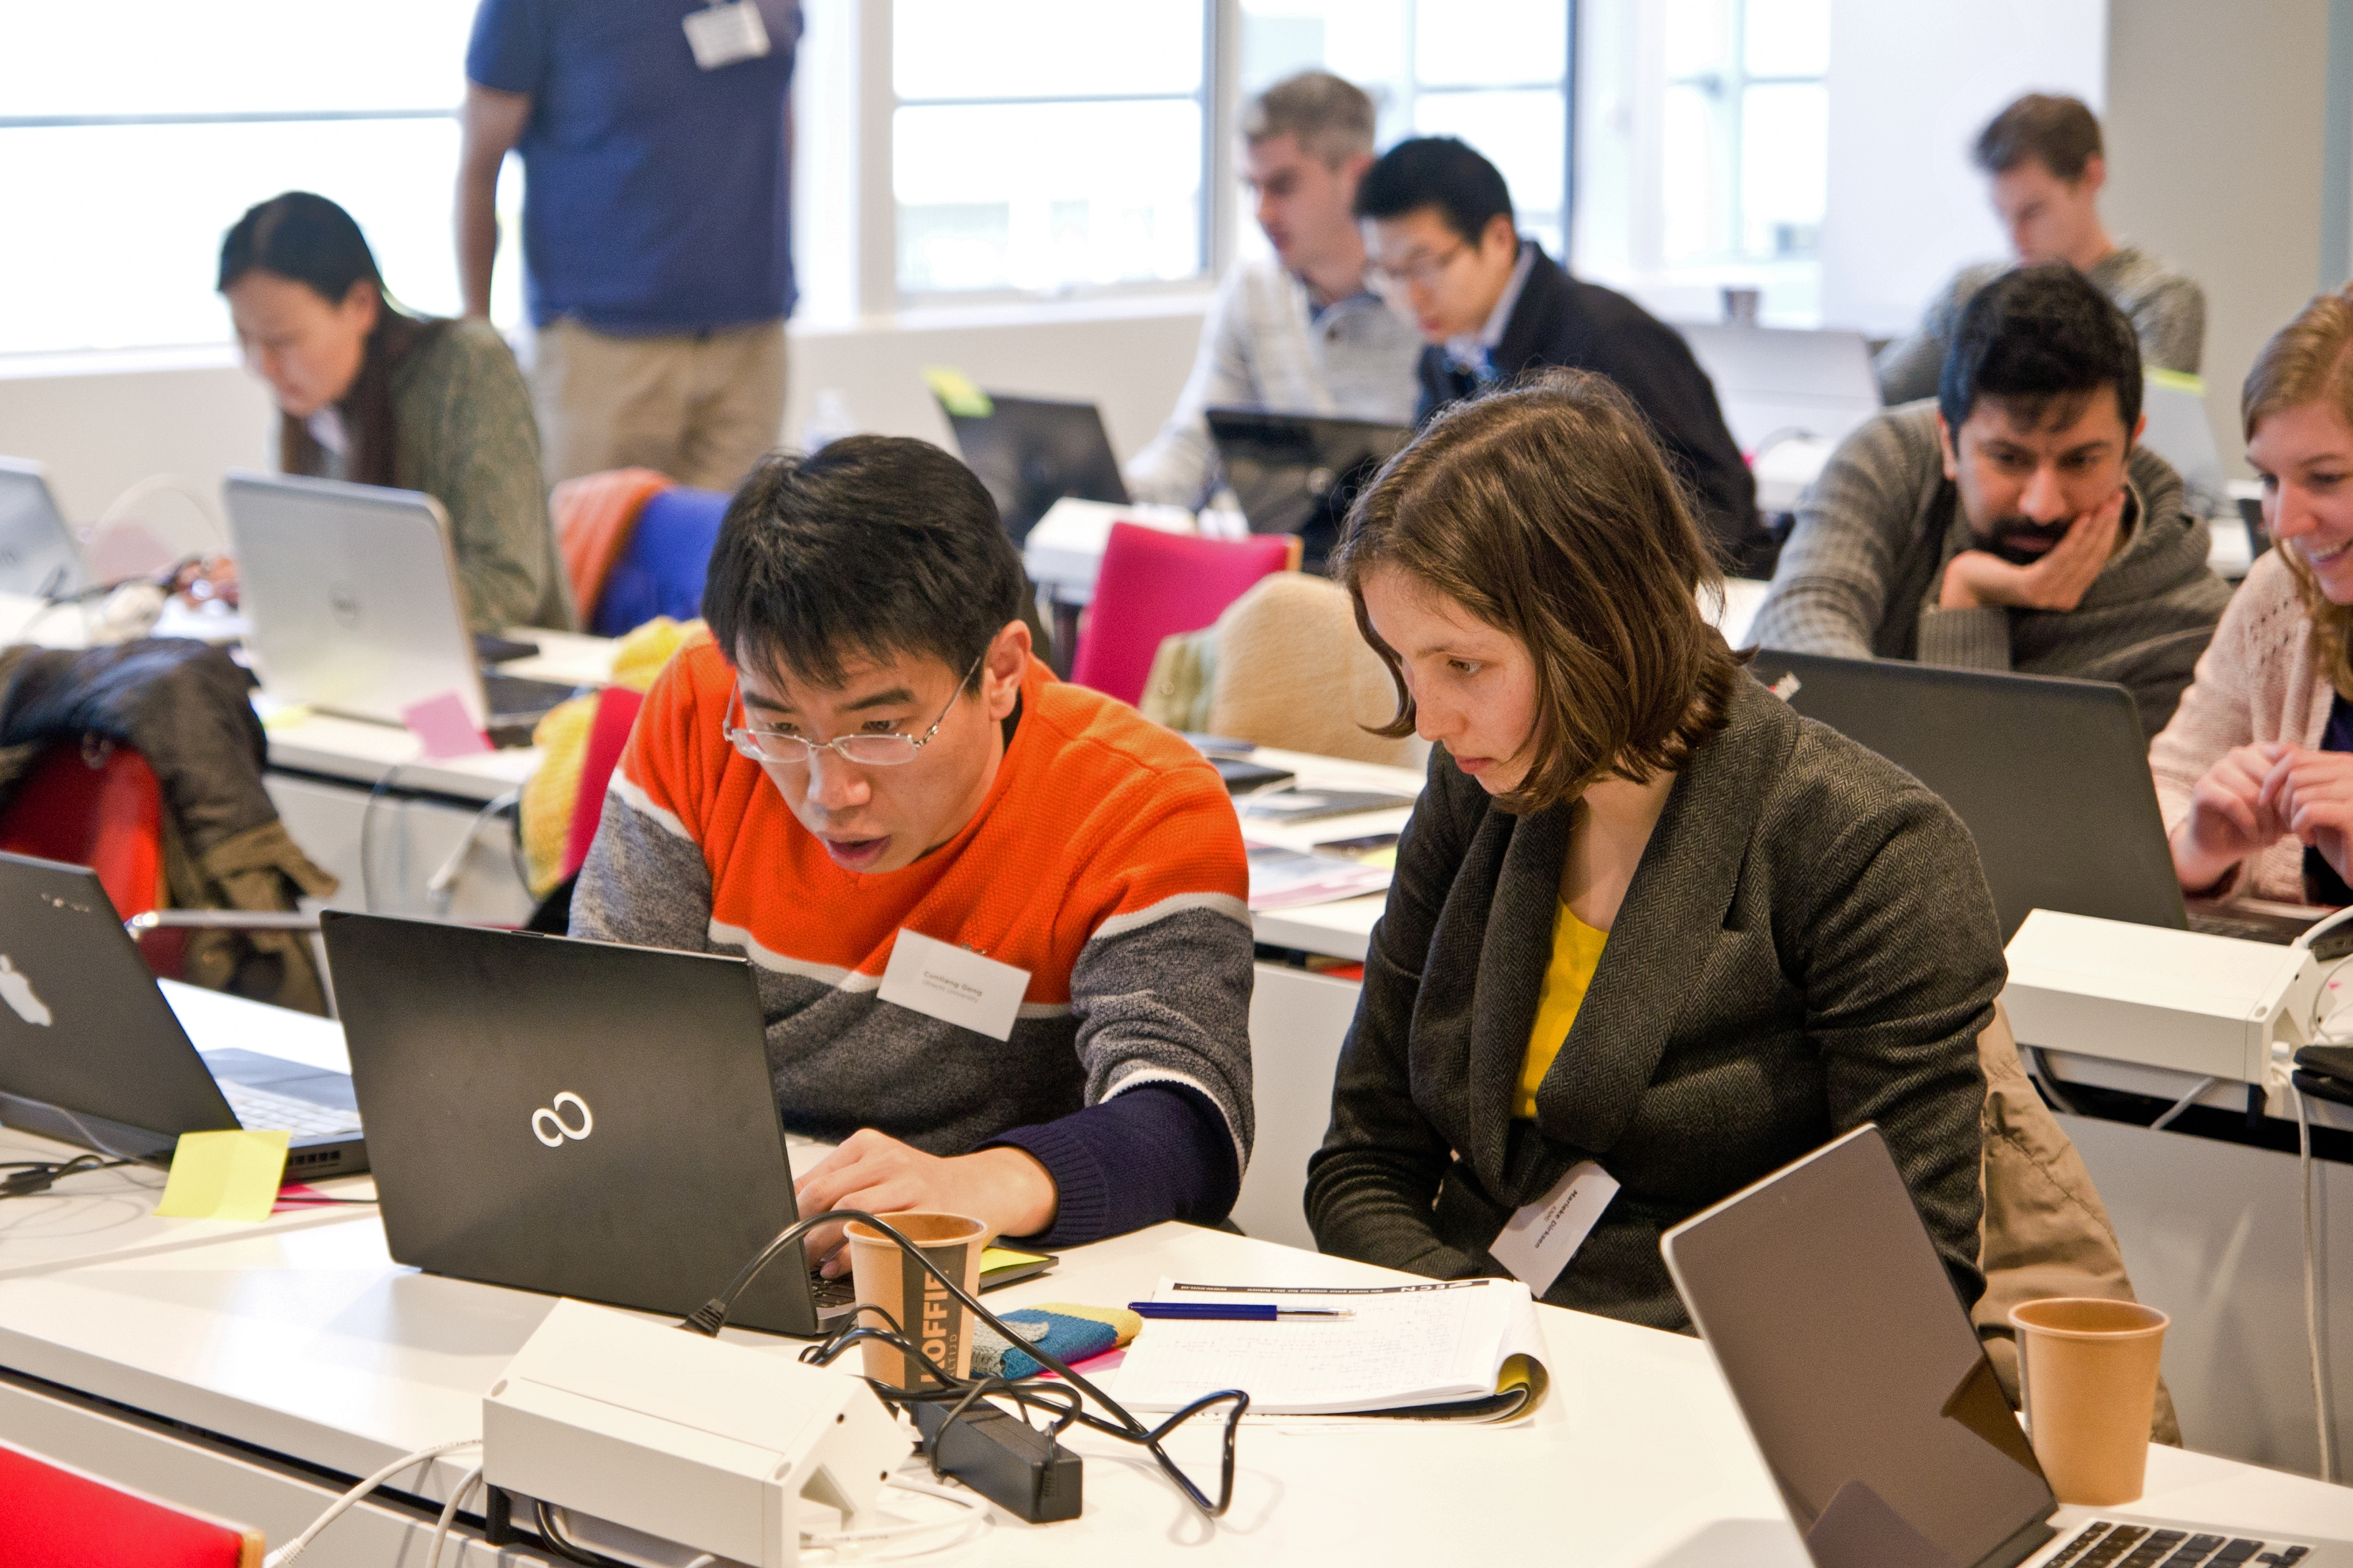


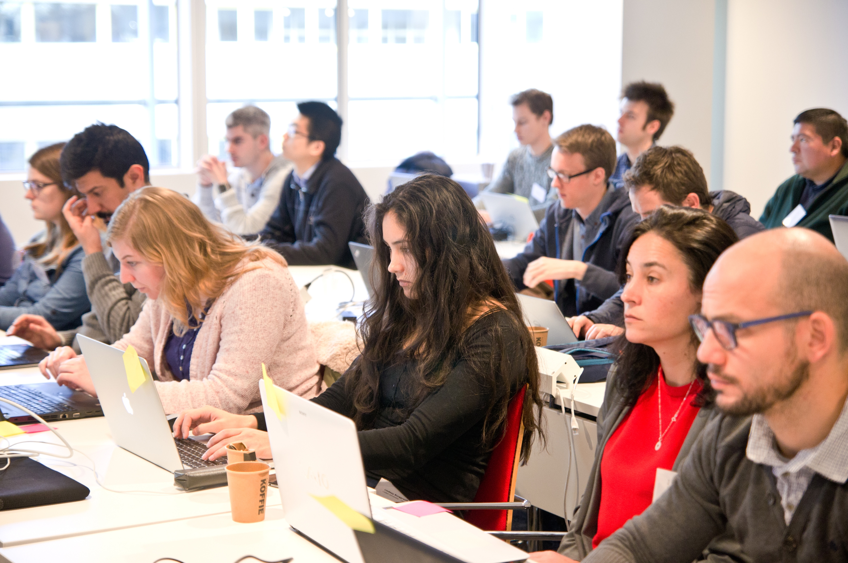

Our Digital Skills Workshops are open to all researchers in the Netherlands. We also offer paid options of standard and custom workshops dedicated to your organisation. To learn more, contact: training@esciencecenter.nl
Do you want us to come and teach a workshop at your organisation?

Slide 6

NL-RSE brings together the community of people writing and contributing to research software from Dutch universities, knowledge institutes, companies and other organizations to share knowledge, to organize meetings, and raise awareness for the scientific recognition of research software.
Website: https://nl-rse.org/
Email: info@nl-rse.org
Twitter: @nl_rse

Slide 7

Research software Training NL
We are a community of training coordinators from Dutch research initiatives delivering training in research software, programming skills, open-source code, and applied data science.
Website: researchsoftwaretraining.nl
Email: rstnl@escience.nl

Slide 8
Submit now!
Become part of the eScience Center community and meet with other Fellows: passionate advocates of research software (3 times a year)
Open to researchers and research software enthusiasts from all disciplines
Receive training, budget and consultancy from eScience Center employees on improving awareness and community efforts around research software
Timeline:
11 April: Deadline project proposal
Early May: Interviews
7 June: kick-off
Fellowship Programme 2023-2024
More info and apply at: esciencecenter.nl/fellowship-programme

Slide 9
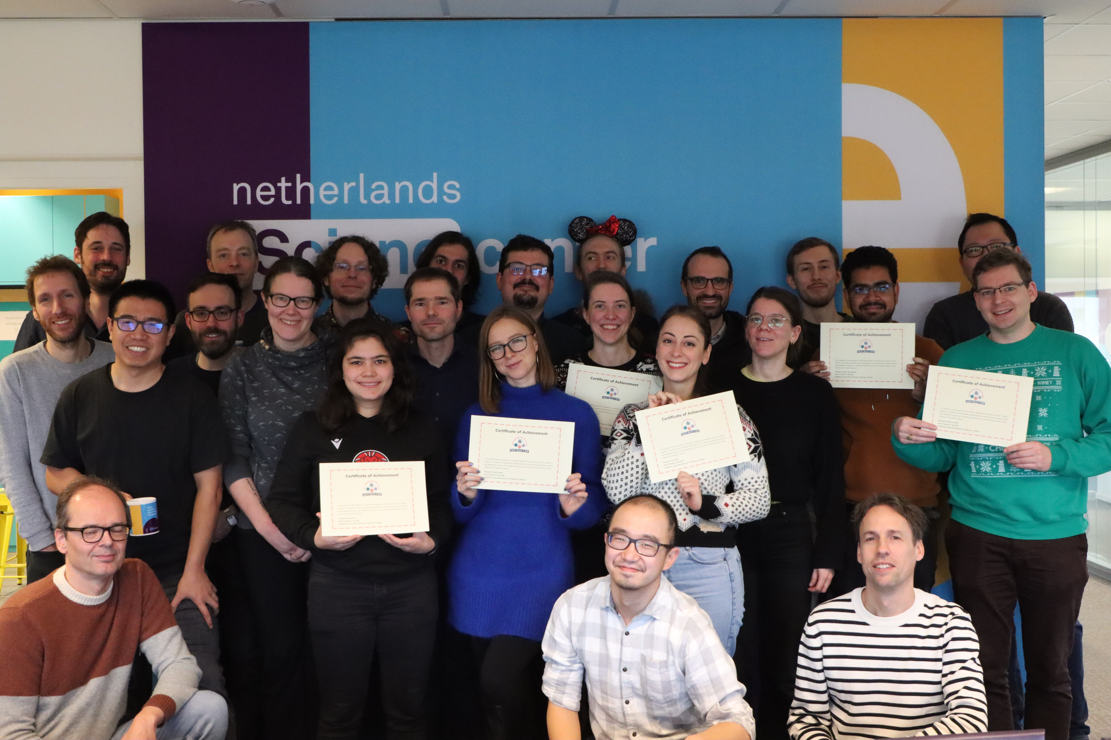
Thank you for attending!
We would love to get your feedback to improve our workshops!
Post-workshop survey

Slide 10
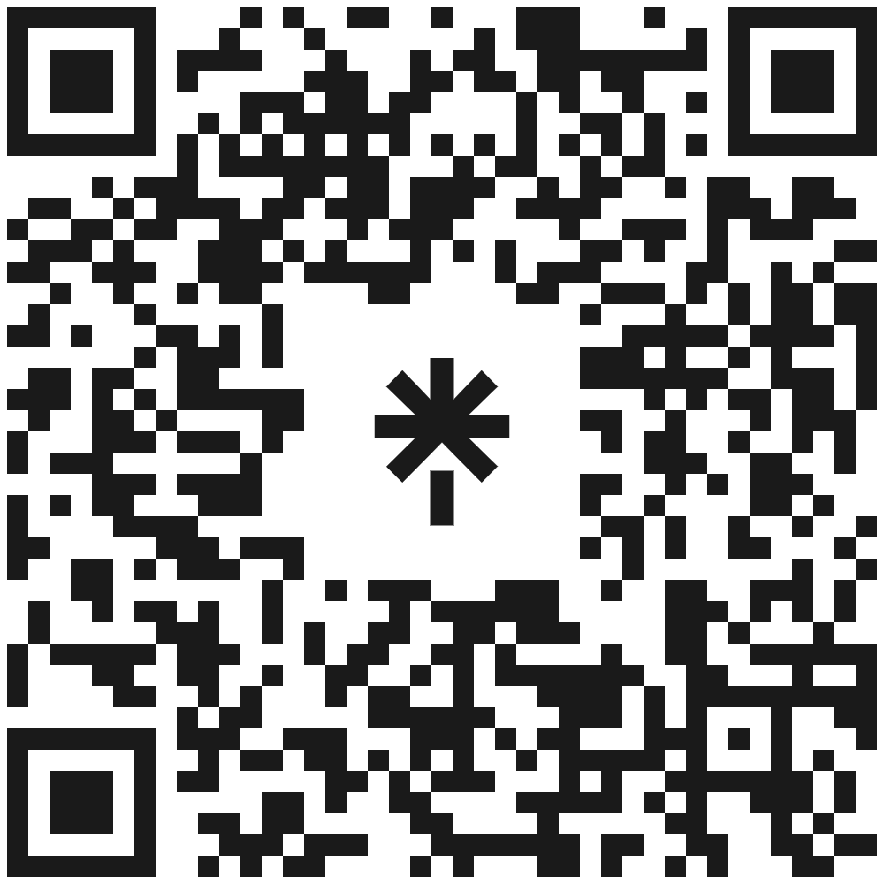







Let’s stay in touch
https://www.esciencecenter.nl/digital-skills/
training@esciencecenter.nl
+31 (0)20 460 4770
@eScienceCenter
Netherlands Escience Center
@eScienceCenter@akademienl.social

